Slide 1
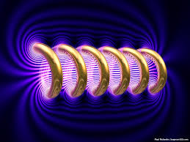


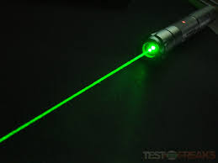

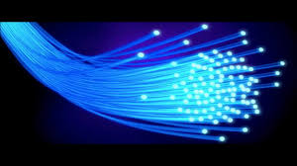
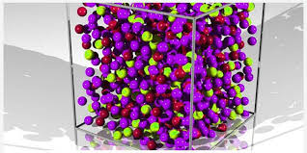
Engineering Physics
PHY-109
FO-2
ELECTROMAGNETIC THEORY
QUANTUM MECHANICS
LASER
WAVES
Dr. Jeeban Pd Gewali
Department of Physics
Lovely Professional University
Phagwara, Punjab-144411
SOLID STATE PHYSICS
FIBER OPTICS

Slide 2
Syllabus
Fiber optics introduction, optical fiber as a dielectric wave guide (Discussion + Video)
Total internal reflection, acceptance angle, numerical aperture, relative refractive index, V-Number
Step index and graded index fibers,
losses associated with optical fibers
Applications of optical fibers

Slide 3
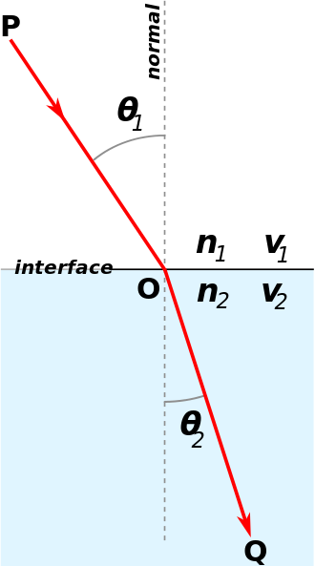
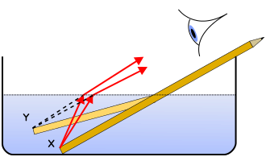
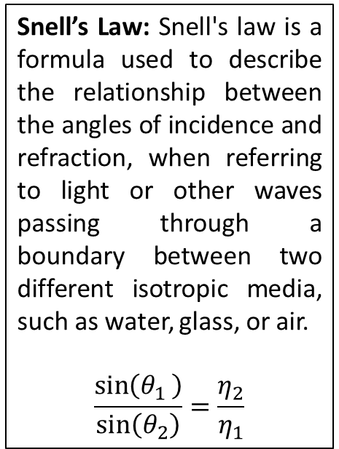
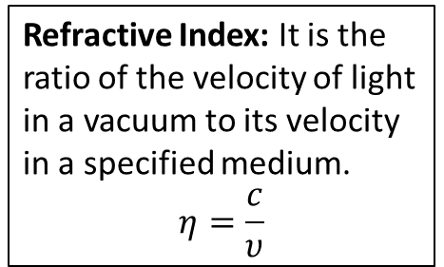
Optical Fiber as Dielectric wave guide
Snell’s Law: Snell's law is a formula used to describe the relationship between the angles of incidence and refraction, when referring to light or other waves passing through a boundary between two different isotropic media, such as water, glass, or air.
$$\frac{\sin\left(θ_{1 }\right)}{\sin\left(θ_{2}\right)}=\frac{η_{2}}{η_{1}}$$
Basics of refraction
Refraction: In physics, the change in direction of a wave passing from one medium to another, caused by its change in speed.
Critical Angle: The critical angle is the angle of incidence for which the angle of refraction is 90°.
Total Internal Reflection (TIR): Total internal reflection is the phenomenon which occurs when a propagated wave strikes a medium boundary at an angle larger than a particular critical angle with respect to the normal to the surface. If the refractive index is lower on the other side of the boundary and the incident angle is greater than the critical angle, the wave cannot pass through and is entirely reflected into the same medium.
Refractive Index: It is the ratio of the velocity of light in a vacuum to its velocity in a specified medium.
$$η=\frac{c}{υ}$$

Slide 4
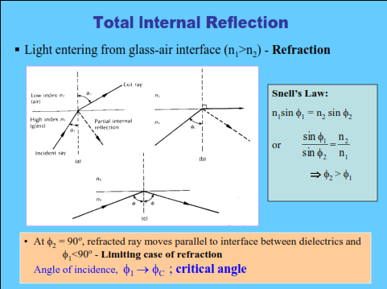
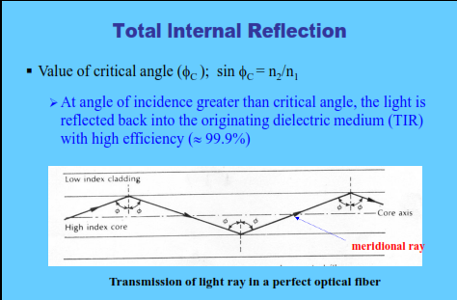

Slide 5
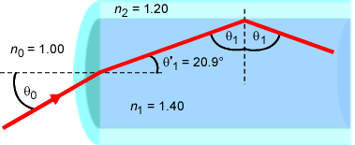
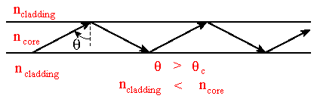
Optical Fiber as Dielectric wave guide
The incident ray at the core-cladding interface happens to incident at an angle greater than the critical angle. Thus, the ray is no more refracted, but, is totally internally reflected back to the core.
The ray again hits the bottom of the fiber cable and totally internally reflected once more.
Thus, by making the zigzag path the ray passes through the fiber.

Slide 6
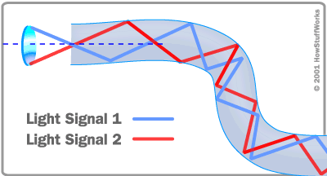
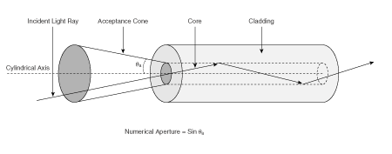

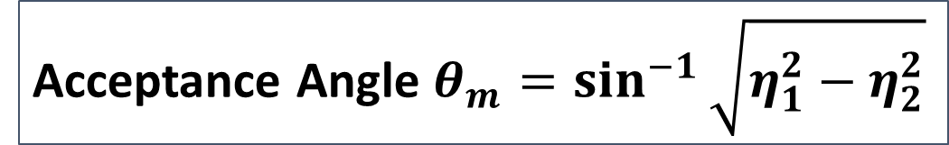








Acceptance Angle
cladding
$$η_{0}<η_{1}$$
B
Refracted Ray
$$φ$$
$$η_{1}>η_{2}$$
A
$$φ$$
Launching End
$$θ_{r}$$
$$η_{0}$$
$$θ_{i}$$
$$η_{1}$$
C
core
Incident Ray
$$η_{2}$$
Acceptance Angle $θ_{m}=\sin^{−1}{\sqrt{η_{1}^{2}−η_{2}^{2}}}$

Slide 7


Slide 8
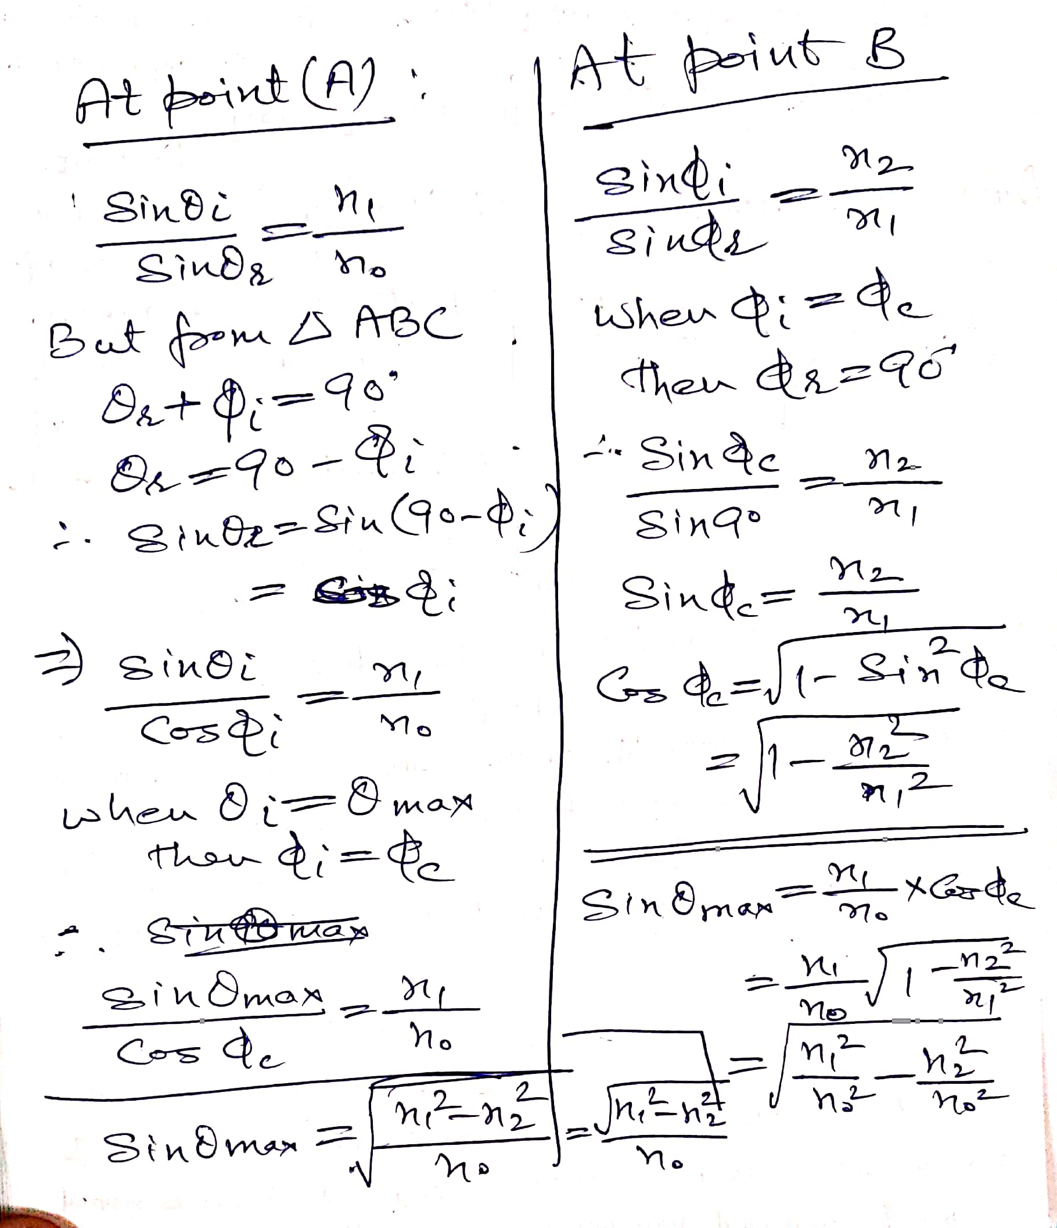
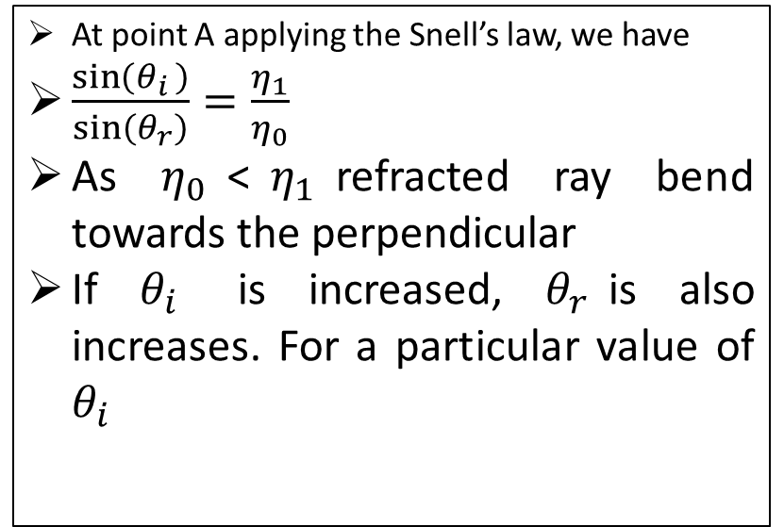
cladding
$$η_{0}<η_{1}$$
B
Refracted Ray
$$φ$$
$$η_{1}>η_{2}$$
A
$$φ$$
Launching End
$$θ_{r}$$
$$η_{0}$$
$$θ_{i}$$
$$η_{1}$$
C
core
Incident Ray
$$η_{2}$$
At point A applying the Snell’s law, we have
$\frac{\sin\left(θ_{i }\right)}{\sin\left(θ_{r}\right)}=\frac{η_{1}}{η_{0}}$
As $η_{0}$<$η_{1}$refracted ray bend towards the perpendicular
If $θ_{i}$ is increased, $θ_{r}$is also increases. For a particular value of $θ_{i}$

Slide 9
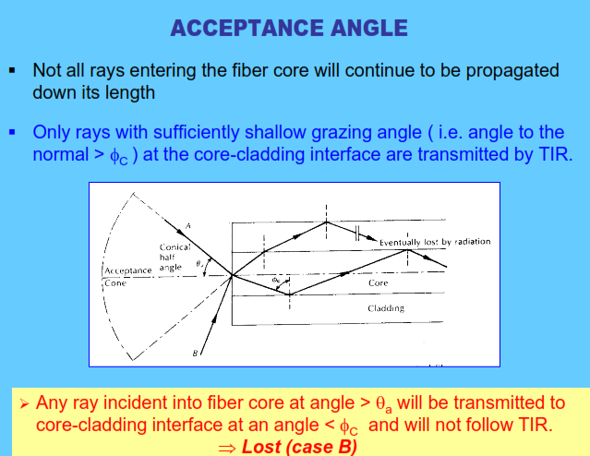

Slide 10
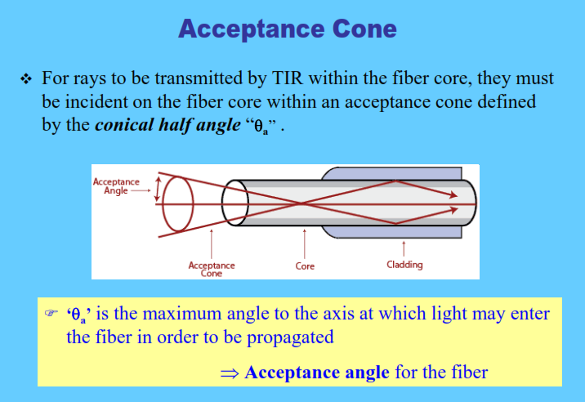

Slide 11
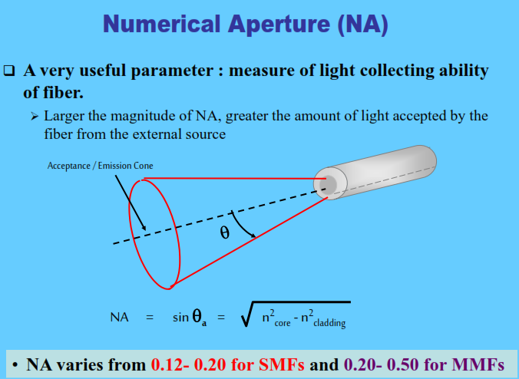

Slide 12
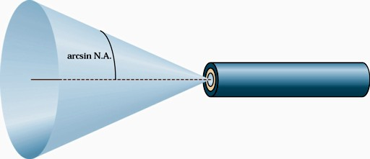
Numerical Aperture
The numerical aperture of the fiber is closely related to the critical angle and is often used in the specification for optical fiber and the components that work with it
The numerical aperture is given by the formula:
The angle of acceptance is sine inverse of numerical aperture.

Slide 13
Numerical Aperture
The larger is the NA, greater the amount of light that can be accepted by fiber. But if NA is too large ,bandwidth of the system degrades.
NA value is always less than 1.
Typical values of NA
0.11 for single mode
0.21 for graded index fiber
0.5 for plastic fiber

Slide 14
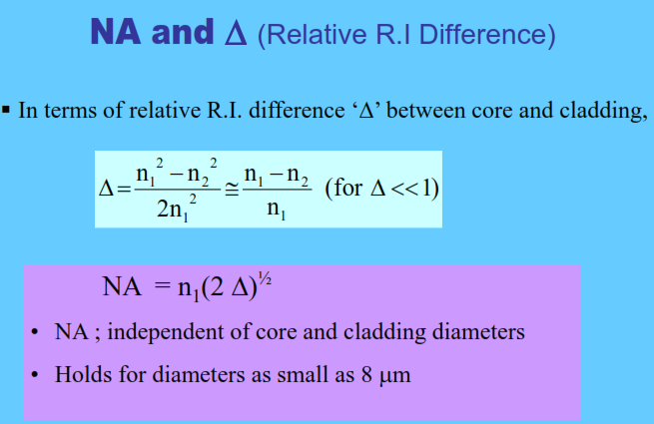

Slide 15
Modes and Materials
Since optical fiber is a waveguide, light can propagate in a number of modes
If a fiber is of large diameter, light entering at different angles will excite different modes while narrow fiber may only excite one mode
Multimode propagation will cause dispersion, which results in the spreading of pulses and limits the usable bandwidth
Single-mode fiber has much less dispersion but is more expensive to produce. Its small size, together with the fact that its numerical aperture is smaller than that of multimode fiber, makes it more difficult to couple to light sources

Slide 16

Number of Supported modes
For step index optical fiber
Where λ is wavelength of light used
a is radius of the core

Slide 17
Normalized wave number or Normalized frequency
V -Number

Slide 18



V- Number
Number of modes supported by optical fiber is obtained by cut-off condition known as Normalized frequency or V-Number
The number of modes

Slide 19
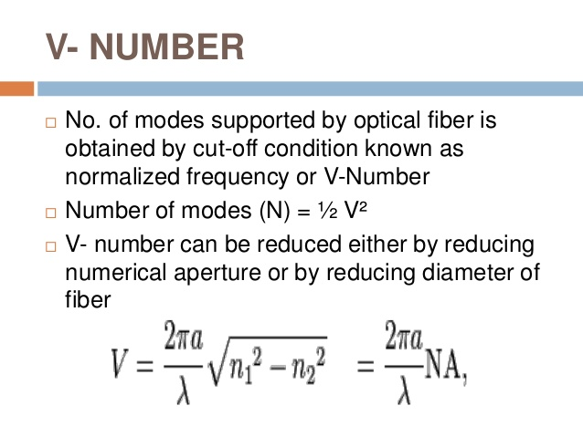

Slide 20
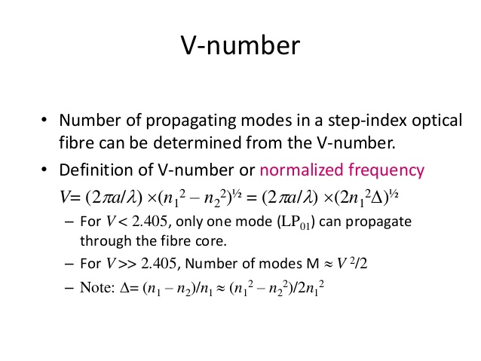
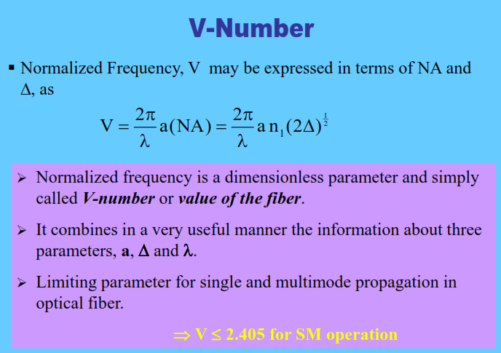

Slide 21
V-Number
http://www.ques10.com/p/5784/explain-the-significance-of-v-number-derive-the-ex/

